Slide 1
BUILDING ENERGY ANALYZER
Assignment 01
Name / Ahmed Zakaria Fayz

Slide 2
Project Overview
How it works:
Cleaning and reading daily consumption figures and room data with a high degree of flexibility.
1
Data processing
2
Calculating total consumption and financial cost for each room and building, on both a monthly and real-time basis.
Cost Accounting
3
Conducting energy-saving simulations and creating illustrative graphs for decision-makers.
Simulation and Visualization

Slide 3
Software architecture of the project
Module 01
(room_manager)
Module 02
(energy_analyzer)
Module 03
(main controller)
--- created class room
Representing room data and electrical loads.
--- created class room_manager
Reading and organizing the rooms.csv file.
--- created class energy_analyzer
Consolidating consumption data..
Implementing scenarios for reducing air conditioning consumption
--- created main.py
Linking modules: executing all functions in a logical order.
Displaying results: printing tables and generating a graph.

Slide 4
TESTING AND VALIDATION
How it works:
Check the file path for CSV files and prevent the program from crashing if data is missing.
1
Checking for the existence of files
2
Filter out missing values ​​(NaN) and remove duplicate rows to ensure the accuracy of calculations.
Cleaning up duplicate and incomplete readings
3
Verify the accuracy of the total consumption calculation and ensure that the simulation results align with the expected figures.
Unit Testing

Slide 5
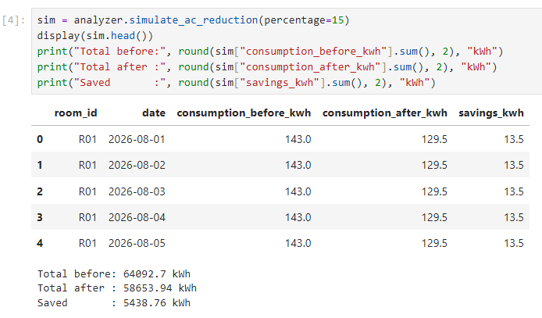
Simulation results for air conditioning consumption optimization
Simulated reduction ratio for the capacity of air conditioning systems in buildings15 %
It leads to a noticeable reduction in total daily and monthly costs, while maintaining the required performance.

Slide 6
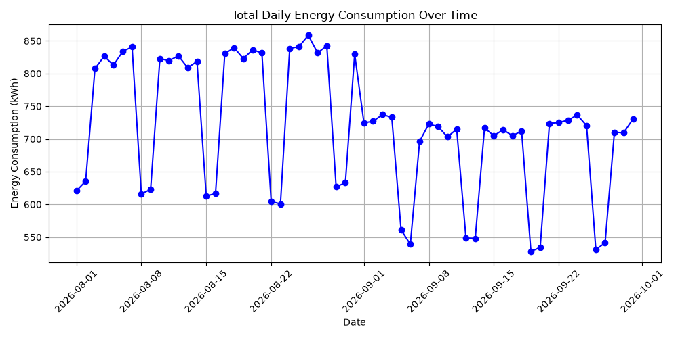
Charts and visual reports
1
Line chart
Monitoring the daily trend of energy consumption over time.

Slide 7
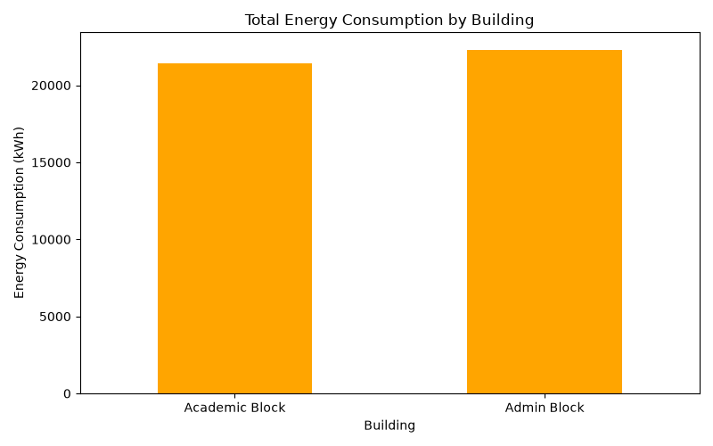
Charts and visual reports
2
Bar chart
Comparing total energy consumption across different buildings.

Slide 8
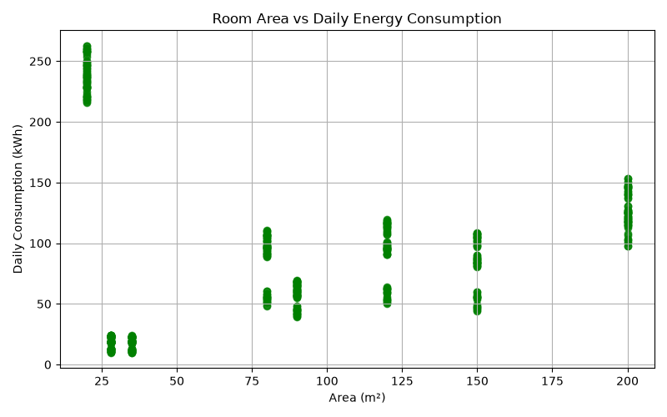
Charts and visual reports
3
Scatter pot
Studying the relationship between room area and the rate of room usage.

Slide 9
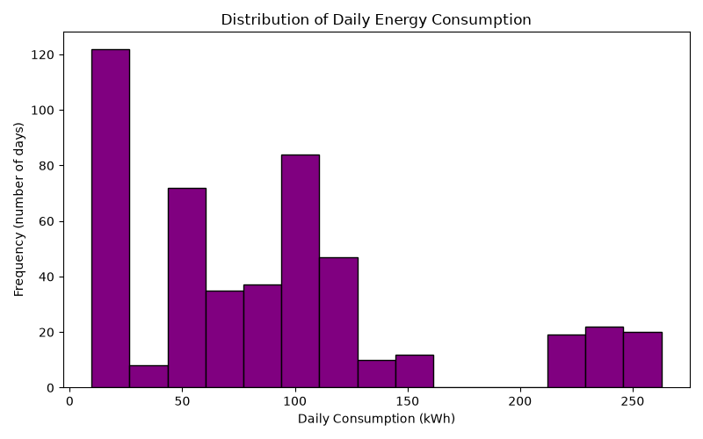
Charts and visual reports
4
histogram_consumption

Slide 10
The repository link
https://github.com/az3858976-hash/ahmed-zakaria.git

